Slide 1
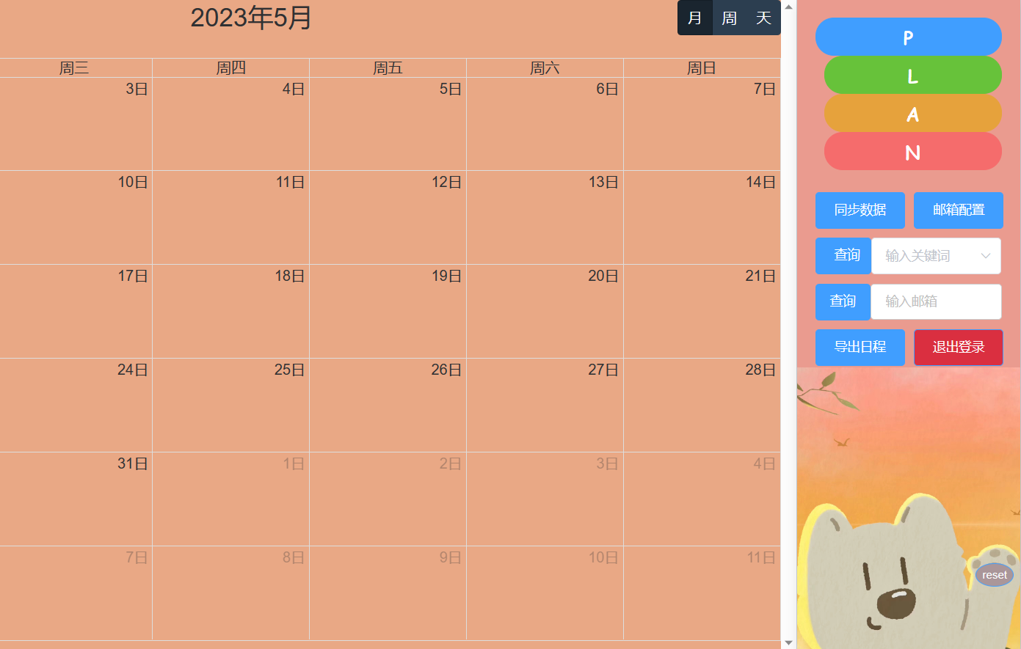
i ·Plan
i ·Plan
i ·Plan
软件项目管理，第二次汇报
Hedy Lamarr
By 黄德玉&谢广伟&刘智清

Slide 2

1
01
Final product demo
2023 6.01

Slide 3

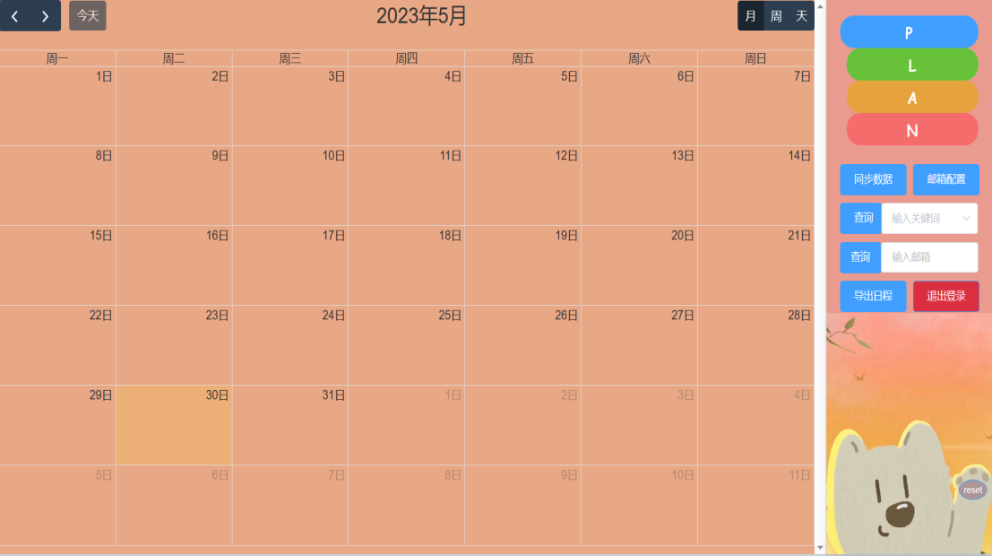


Function demonstration
Function demonstration
We developed a schedule web application called iPlan based on Outlook data synchronization. This application allows users to create personal schedules and view email data conveniently.

Slide 4
02
Test plan/Test cases
2023 6.01

Slide 5
our test plan
test plan
The number of
test casesI
Testing tool
Our project uses JUnit5 for automated testing of project functionality. JUnit is one of the most popular automated testing frameworks in Java, used for writing and running unit tests. JUnit has extensive community support and well-documented resources, as well as being easy to learn, powerful, and flexible, making it widely used in the Java development field.
22
The number of interfaces
12
Method URL：
01
private static final String saveOrUpdate = "/dailyPlan/saveOrUpdate";
Read JSON document as input parameter
02
@Value("classpath:data/queryPlanDataSaveOrUpdate.json")
private Resource queryPlanDataSaveOrUpdate;
Automated testing start button
03
@Test
public void saveOrUpdate() throws Exception{
AddDailyPlanRequest request = objectMapper.readValue(queryPlanDataSaveOrUpdate.getInputStream(),AddDailyPlanRequest.class);
AddDailyPlanResponse response = restPost(saveOrUpdate,request,AddDailyPlanResponse.class);
assertThat(response.getCode(),equalTo(ErrorCode.SUCCESS.getCode()));
}

Slide 6


TEST
case group
"userName": "",
"sender": "",
"receiver": "",
"title": "",
"content": "",
"position":"",
"startTime": "",
"endTime": "",
"planId": ""
"userName": "monkey",
"sender": "liuzhiqing@qq.com",
"receiver": "huangdeyu@outlook.com",
"title": "第一次小组会议",
"content": "全体会议",
"position":"信工315",
"startTime": "2023-10-25",
"endTime": "2023-10-25",
"planId": ""
null
4
1
2
"userName": "panda",
"sender":"xieguangwei@qq.com",
"receiver": "liuzhiqing@outlook.com",
"title": "长字符串测试......长度测试",
"content": "全体会议",
"position":"401会议室",
"startTime": "2023-10-25 23:00:00",
"endTime": "2023-10-25 24:00:00",
"planId": ""
3
4
"userName": “cat",
"sender": "huangdeyu@163.com",
"receiver": "xieguangwei@outlook.com",
"title": "这是一个普通主题",
"content": "全体会议",
"position":"401会议室",
"startTime": "2023-10-25 23:00:00",
"endTime": "2023-10-25 24:00:00",
"planId": ""

Slide 7
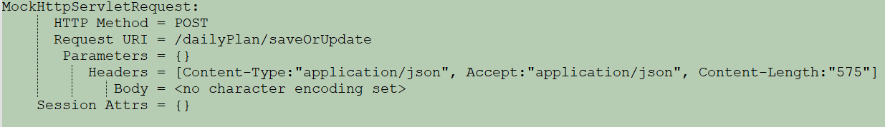
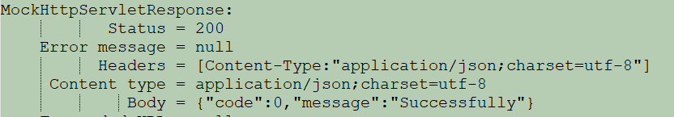
CASE.
01
Test feedback.
An error will be thrown when executing the first test case.
CASE
02
03
04
Request:
The last three test cases were executed correctly without any errors, and returned the following information
Response:

Slide 8
03
Project execution detail
2023 6.01

Slide 9
Team discussion
Communication makes progress for us
Group discussion lasting 1 to 2 hours:
 | 3.17 | 4.18 | 5.6 | 5.27
Discussion content | Technical framework | Learning progress of the front-end | Project submission delay issue | Preparation of content for final report and PPT
Daily discussion:
 | Every Tuesday night
Discussion content | Project progress, learning progress, and issues encountered, etc.

Slide 10
Technical learning
Technical learning
VUE2
03
Similarity algorithm.
02
04
Full calendar
Technical learning
Exchange Server
01
05
Git

Slide 11





The main development software used.
development software
Choosing the appropriate development software can improve the team's work efficiency and the quality of project completion.
01
IDEA is powerful and efficient features are loved by Java developers
02
We use VS Code to write front-end code in our project.
03
Navicat helps us to establish a stable connection with the database and facilitates editing.
04
We deploy the project using Ubuntu and dynamically modify the configuration file..
IDEA
VS Code
Navicat
Ubuntu
Postman
05
Using Postman, we can simulate the frontend's request to the backend API.

Slide 12
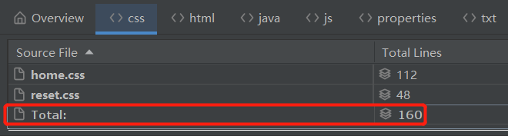
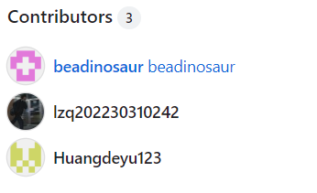
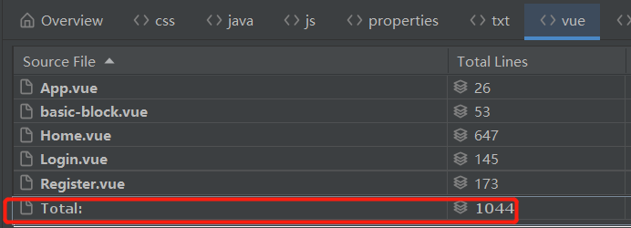
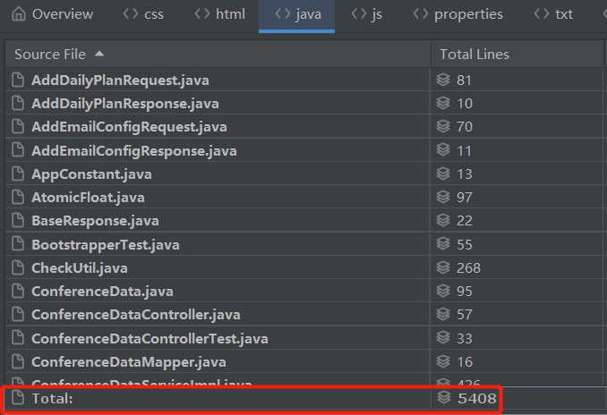
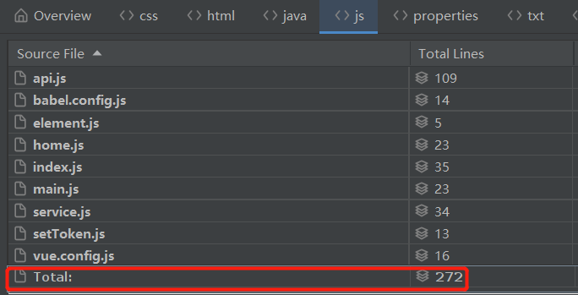
Code delivery
Code delivery
drivers:.
css = 160.
vue = 1044.
java = 5408.
js = 272.

Slide 13
04
Rick Plan and Analysis
2023 6.01

Slide 14
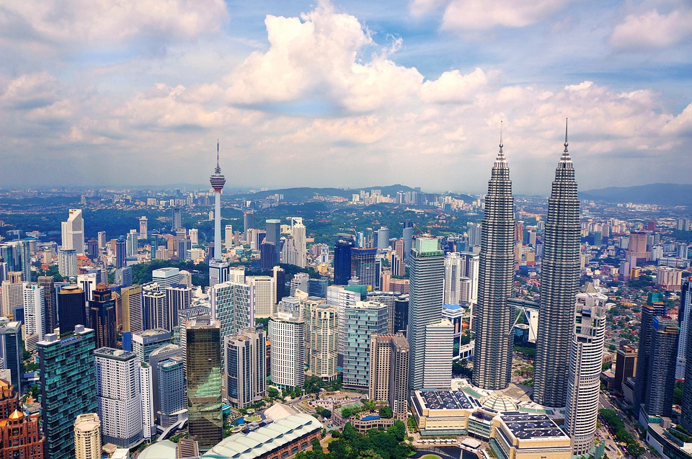
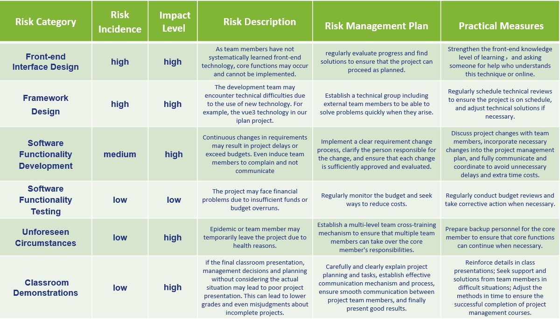

Risk Plan

Slide 15
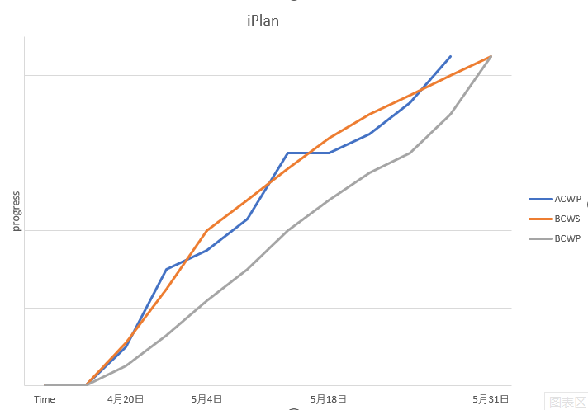
Risk Analysis
BCWS：Indicates the budgeted cost of actual work performed
BCWP：Indicates planned work budget costs
ACWP：Indicates the actual cost of completing the work
 | BCWS | BCWP | ACWP
4月20日 | ↑ | ↓ | ↓
4月20日-5月4日 | ↘↗ | ↓ | ↗↘
5月4日 | ↑ | ↓ | ↓
5月4日-5月18日 | ↑ | ↓ | ↗↘
5月18日 | ↑ | ↓ | ↓
5月18日-5月31日 | ↘ | ↓ | ↗
5月31日 | → | → | →
Submit node 1
Submit node 2
Submit node 3
Submit node 4

Slide 16
05
Summary of the project
2023 6.01

Slide 17
Summary of the project：
1.Summarize project achievement
List the Iplan project's major achievements and goals, as well as the value of the functionality achieved throughout the project.
2.Summarize project experience
Summarize the experience and lessons of project management, technical implementation, teamwork and personal growth in the iplan project.
3.Future plan
Follow-up maintenance and function upgrade of iplan project

Slide 18
1.Summarize project main achevement
target function | performance | functional description | value
Login/Register | success | The user registers for a new account, logs in to the application using that account | Can bind an email address to the user to synchronize data with the corresponding user
Add/Modify/Delete schedule | success | The user can manually add a schedule, and modify or delete the schedule afterwards. | The user can use the application and maintain the schedule data without configuring an email.
Email configuration and data synchronizationnal account | success | The user binds their personal Outlook email account.Then periodically or manually pull the email or meeting information from the outlook mailbox to generate a personal calendar after filtering | Make it easy for users to view the data bound to their email account, and unify the format of emails and meeting information.
View the schedule | success | The users can view the schedule by month, week, or day. | Multiple viewing interfaces are provided to meet the different viewing needs of users.
Email filtering | success | Filter out certain emails based on blocked topic keywords or blocked email addresses, and synchronize only the latest email with a subject similarity of more than 0.8. | Help users filter out spam emails to make the interface cleaner.
Search the schedule based on hot words. | success | Hot words are the top ten nouns in frequency that are obtained by the system's word segmentation of each topic when adding it to the schedule | Make it easy for users to view high-frequency subject schedules.
Search the schedule based on email address. | success | Enter the specified sender's email address to query all schedules from that source. | Make it easy for users to view all email messages from a particular sender.
Export schedule data | success | Export schedule data to an Excel spreadsheet based on the query results | Make it easy for users to view schedules offline.

Slide 19


2.Summarize project experience
Technology level：
The difficulty of the project is underestimated, and the cost of learning time is greatly increased,especially the front-end Vue technology.
Team level:
Recognition among members is very important, and good communication is needed to reduce misunderstanding.
Personal growth level :
Before starting the project, be sure to assess the finish possibilities to avoid unnecessary changes and project delays.

Slide 20
06
Future plan for next cycle
2023 6.01

Slide 21
3.Future plan
Future plan
80%
100%
Regarding the follow-up work of the project, we hope to further optimize the code and reduce redundancy. We also plan to sort out a technical document as a personal learning record, identify weak points, and establish new learning plans.
40%
60%
20%

Slide 22

THE END

